Slide 1

Air Traffic Control: A Case Study in Designing for High Availability
Teacher: Huang wu
2019/10/29 Chengdu

Slide 2

Midterm examination

Slide 3
Outline
Background of ATC System
Introduction of ISSS system
The Architecture of the ISSS system
Summary of the ATC system achieves the quality goal
38

Slide 4
1. Background of ATC system
Air traffic control (ATC) is a kind of service that guides the aircraft to operate normally on the ground and in the air based on the ground control equipment
The task of the ATC is monitoring for flying separation, formulating and issuing clearances to resolve conflicts, and sequencing traffic according to flow restrictions.
38

Slide 5
1.1 ATC system
The ATC system is a complete set of auxiliary equipment, including radar, radar display, data communication, data recording, etc..
The most important of which is radar data processing and radar display terminal.
38

Slide 6
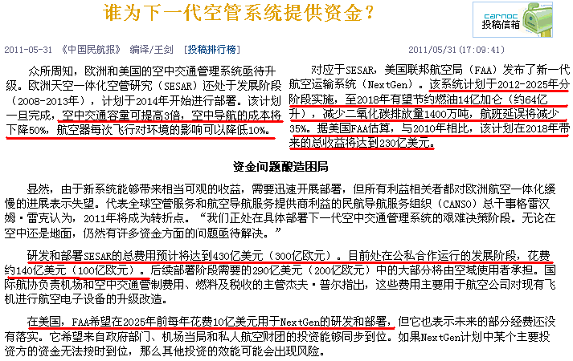
1.1 The importance of ATC system
38

Slide 7
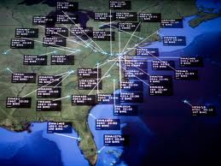
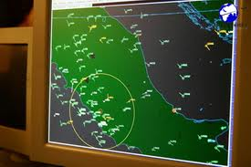
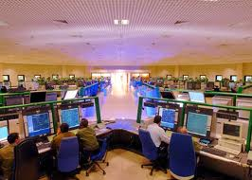

1.2 Example of ATC system
38

Slide 8
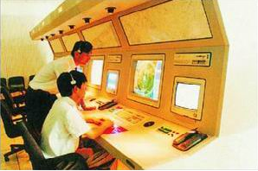
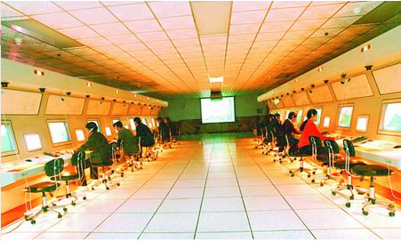
1.2 ATC simulation system
Sichuan university produced
Beijing
Tianjin
38

Slide 9
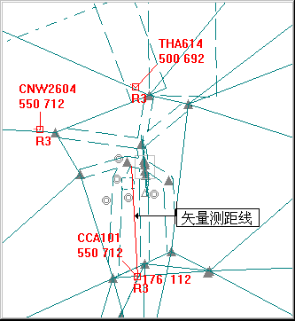

1.3 The radar display in ATC
Primary radar
Secondary Surveillance Radar
38

Slide 10
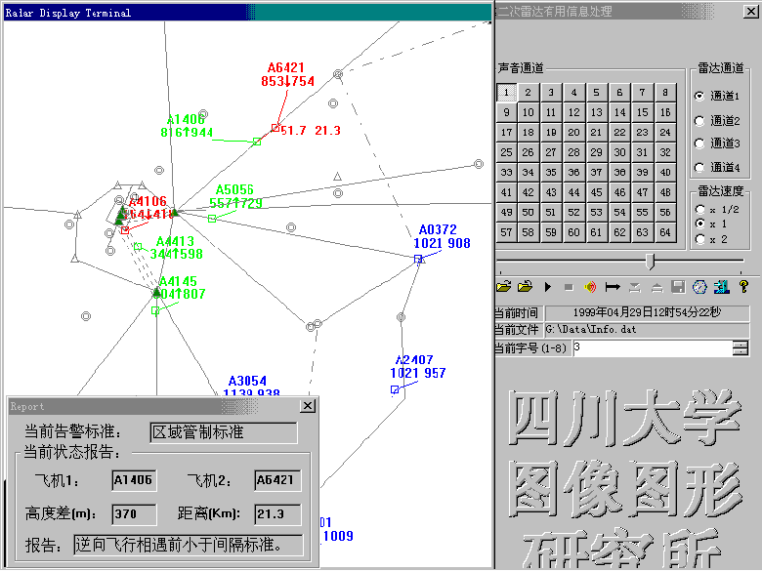
1.3 The radar display in ATC
38

Slide 11
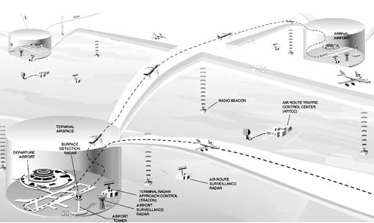
1.4 Control process of ATC
Fig1. Flying from point A to point B
38

Slide 12
2. Introduction of ISSS system
The system we will study is called the Initial Sector Suite System (ISSS), which was intended to be an upgraded hardware and software system for the 22 en route centers in the United States.
It upgraded systems in the towers and ground control facilities, as well as the transoceanic ATC facilities.
38

Slide 13
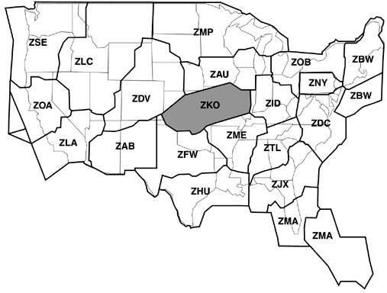
2.1 22 En route centers in the United States
Fig2. 22 En route centers in the United States
38

Slide 14
2.2 sector suite
S1
2
2
S2


3
1

3
1



S3

4
5
4
5

Whole display
Sector suite
ATC console
Fig3. Conception of sector suite
38

Slide 15
2.3 Main quality attributes of ISSS system
Ultrahigh availability. The actual availability requirement is targeted at 0.99999, meaning that the system should be unavailable for less than 5 minutes a year.
High performance, meaning that the system has to be able to process large numbers of aircraft—as many as 2,440—without "losing" any of them.
38

Slide 16
2.3.1 The other quality attributes of ISSS
Openness, meaning that the system has to be able to incorporate commercially developed software components
The ability to field subsets of the system
The ability to make modifications to the functionality and handle upgrades in hardware and software
The ability to operate with and interface to a set of external systems
38

Slide 17
2.4 The scale of the ISSS
ISSS is designed to support up to 210 consoles per en route center
ISSS requirements call for a center to control from 400 to 2,440 aircraft tracks simultaneously
There may be 16 to 40 radars to support a single facility
The code to implement ISSS contains about 1 million lines of Ada.
38

Slide 18
2.5 Function of the ISSS
Acquire radar target reports that are stored in the Host Computer System.
Convert the radar reports for display
Handle conflict alerts
Interface to the Host for input and retrieval of flight plans
Provide extensive monitoring and control information
Provide a recording capability for later playback
38

Slide 19
3. The Architecture of the ISSS system
Architecture affects behavior, performance, fault tolerance, and maintainability, so it is shaped by stringent requirements in any of these areas.
In the case of ISSS, by far the most important driving force is the extraordinarily high availability: less than 5 minutes per year of downtime.
38

Slide 20
3.1 Physical View
ISSS is a distributed system, consisting of a number of elements connected by local area networks. The major elements are as follows:
The Host Computer System (HCS)
Common consoles are the air traffic controller's workstations
Local Communications Network (LCN)
38

Slide 21
3.1.1 Physical View Elements
The Enhanced Direct Access Radar Channel (EDARC)
External System Interface (ESI)
The Backup Communications Network (BCN)
Monitor-and-Control (M&C) consoles
The Test and Training subsystem
The central processors provide the data recording and playback functions
38

Slide 22
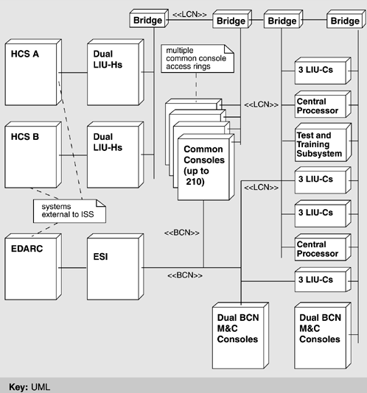
Data
Display
Backup
Tactics：
Redundancy
State resynchronization
Spare
…
38

Slide 23
3.2 Module Decomposition View
The module elements of the ISSS operational software are called Computer Software Configuration Items (CSCIs)
ISSS System
Display Management
Common System Services
Recording, Analysis, Playback
National Airspace System Modification
IBM AIX operating system
38

Slide 24
3.3 Process View
The basis of concurrency in ISSS resides in elements called applications. An application corresponds roughly to a process
ISSS is constructed to operate on a plurality of processors. Processors are logically combined to form a processor group, the purpose of which is to host separate copies of one or more applications.
38

Slide 25
3.3.1 The Operational Unit and Functional Groups
The different application copies are referred to as primary address space (PAS) or standby address space (SAS). The collection of one PAS and its attendant SASs is called an operational unit (OU).
The functional groups (FG) are processes that simply run independently on different processors.
38

Slide 26
3.3.2 The Relationship between OU and FG
an application may be either an operating unit or a functional group.
The two differ in whether the application's functionality is backed up by one or more secondary copies, which keep up with the state and data of the primary copy and wait to take over in case the primary copy fails. Operational units have this fault-tolerant design; functional groups do not.
38

Slide 27
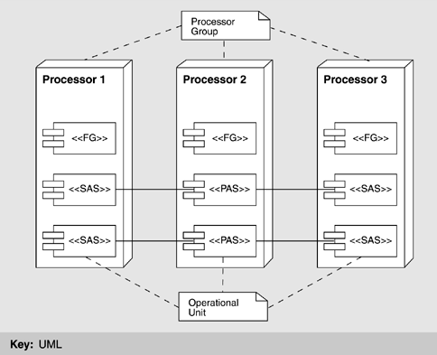
What tactics does the operational unit use?
OU
Fig.4 Process view
38

Slide 28
3.3.4 How does the SAS take over the PAS
A SAS is promoted to the new PAS.
The new PAS reconstitutes with the clients of that operational unit by sending them a message
A new SAS is started to replace the previous PAS.
The newly started SAS announces itself to the new PAS
38

Slide 29
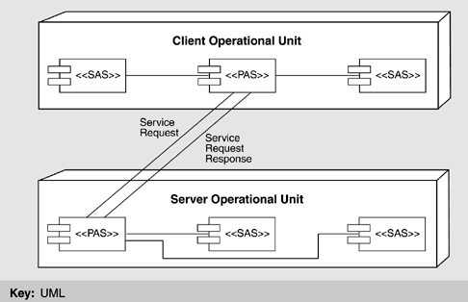
3.4 Client / Server View
The modifiability tactics of "maintaining interface stability," "component replacement," and "adherence to defined protocols."
Fig.5 Client-server view of the system
38

Slide 30
3.5 Fault Tolerance View
The ISSS fault-tolerant hierarchy provides various levels of fault detection and recovery. Each level asynchronously
Detects errors in self, peers, and lower levels.
Handles exceptions from lower levels.
Diagnoses, recovers, reports, or raises exceptions.
38

Slide 31
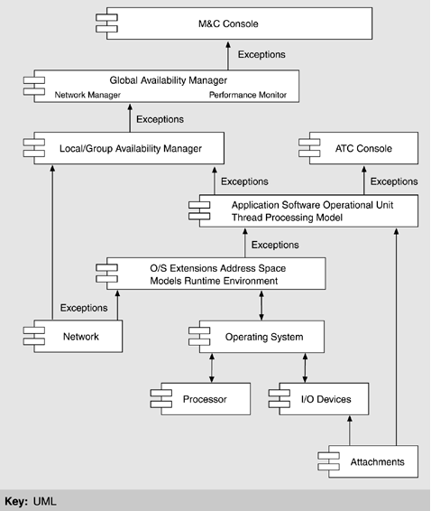
⑦ M&C
⑥ GAM
⑤ LAM
Tactics：
Redundancy
Ping/Echo
Heart beat
…
④Application
③Runtime
② OS
① Physical layer
38

Slide 32
3.6 Code Templates for Applications
PAS and SAS have same source code，primary copy is executing, it sends state information from time to time to all of the secondary copies so that they can take up execution when called on
The structure is a continuous loop that services incoming events.
38

Slide 33
3.6.1 Code Template
terminate:= false
initialize application/application protocols
ask for current state (image request)
Loop
Get_event
Case Event_Type is
-- "normal" (non-fault-tolerant-related) requests to perform actions;
-- only happens if this unit is the current primary address space
when X=> Process X
Send state data updates to other address spaces
when Y=>Process Y
Send state data updates to other address spaces
...
when Terminate_Directive => clean up resources; terminate := true
when State_Data_Update => apply to state data
-- will only happen if this unit is a secondary address space, receiving
-- the update from the primary after it has completed a "normal" action
-- sending, receiving state data
when Image_Request => send current state data to new address space
when State_Data_Image => Initialize state data
when Switch_Directive => notify service packages of change in rank
when Recon_from_A=>reconstitute A
when Recon_from_B=>reconstitute B
...
when others=>log error
end case
exit when terminate
end loop
38

Slide 34
3.6.2 Abstract of Code Template
Loop
1. Normally process events
2. Update the states
3. Send and receive data
4. Switchover the SAS and PAS
5. Accomplish original client’s request
End loop
38

Slide 35
4. Summary of the ATC system achieves the quality goal
Goal | How Achieved | Tactics used
High Availability | Hardware redundancy (both processor and network); software redundancy (layered fault detection and recovery) | State resynchronization; shadowing; active redundancy; removal from service; limit exposure; ping/echo; heartbeat; exception; spare
High Performance | Distributed multiprocessors; front-end schedulability analysis, and network modeling | Introduce concurrency
Openness | Interface wrapping and layering | Abstract common services; maintain interface stability
38

Slide 36
View
Background
Realize
ATC system
Architecture
Realize
Physical View
Process View
Fault Tolerance View
Code Template
…
Quality attributes
Include
High availability
Performance
38

Slide 37
Homework
What availability tactics are used in the ISSS system. Explain these tactics.
What would our architecture look like if we removed support for availability？
38

Slide 38
Discuss
Security and usability are often seen to be at odds with each other. Security often imposes procedures and processes that seem like needless overhead to the casual user. But some say that security and usability go hand in hand and argue that making the system easy to use securely.
How do you coordinate the security and the usability?
38

